Slide 1
Te kuptojme AD/Active Directory
Notes:
1 minute

Slide 2
Sherbimet Direktori AD/Active Directory Domain Services
(AD DS)

Slide 3
Module Overview
Pamje e pergjithshme e sherbimeve direktori
Komponentet fizike AD ne sherbimet direktori/AD DS
Komponentet logjike ne sherbimet AD/AD DS

Slide 4
Pamje e pergjithshme e sherbimeve direktori
Protokolli
Cfare eshte autentifikimi?
Cfare eshte autorizimi?
Perse te shperndajme sherbimet direktori?
Menaxhimi i centralizuar i rrjetit
Specifikat per instalimin e sherbimeve direktori
Pamje e pergjithshme e sherbimeve direktori dhe DNS
Pamje e pergjithshme e komponenteve te sherbimit direktori AD DS

Slide 5
Protokolli LDAP
Lightweight Directory Access Protocol (LDAP)
Standarti X.500
I bazuar ne TCP/IP
Nje metode per aksesimin, kerkimin dhe modifikimin e nje sherbimi direktori
Nje model klient-server

Slide 6
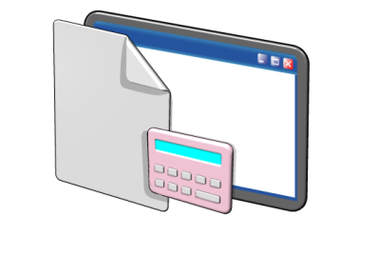
Cfare eshte autentifikimi?
Authentifikimi eshte procesi i verifikimit te identitetit te nje perdoruesi ne rrjet
Authentifikimi perfshin dy komponente:
Logim interaktiv: jepet akses ne PC-ne lokal
Autentifikim ne rrjet: jepet akses ne burimet e rrjetit
Notes:
A passport is a good analogy for authentication. It is a means by which a user can verify they are who they say they are.
The most common way for users to authenticate is by providing a user name and password. However, some computer systems also support authentication based on smart cards, one-time passwords, or biometric information, such as fingerprint scans.

Slide 7
Cfare eshte autorizimi ?
Authorizimi eshte procesi i verifiikimit qe nje perdorues i autentiifikuar ka te drejte te kryeje nje veprim
Kerkohet krijimi i (SIDs) kur llogaria krijohet fillimisht
Llogarive te perdoruesit ju jepen tokena sigurie gjate autentifikimit qe perfshijne SID te perdoruesit dhe te gjitha SID e lidhura me grupin
Burimet e ndara ne rrjet perfshijne listat e kontrollit te asesit (ACL) qe percakton se kush mund ti aksesoje keto burime
Tokeni i sigurise krahasohet me listen e kontrollit te aksesit te direktorise) per kete burim dhe aksesi ose jepet ose hiqet
Notes:
Some of the types of attributes that might be contained in the security token are user group, ownership, and admin privileges.
The security identifier (SID) attribute is unique for each user or security group, and is the primary means by which the security principal is identified when trying to access network resources.
Authorization happens frequently and unobtrusively whenever users request services, like opening their home folder, reading/writing files, or when requesting access to an AD DS aware application. The user only sees the result of the authorization--they are granted or denied access.
An access control list (ACL) is a list of access control entries (ACE). Each ACE in an ACL identifies a security principal and the access rights allowed, denied, or audited for that principal. The security descriptor for a securable object can contain two types of ACLs: a DACL and a SACL.
A discretionary access control list (DACL) identifies the security principals that are allowed or denied access to an object. When a person or process tries to access an object, the system checks the ACEs in the object's DACL to determine whether to grant access to it. If the object does not have a DACL, the system grants full access to everyone. If the object's DACL has no ACEs, the system denies all attempts to access the object because the DACL does not allow any access rights.
A system access control list (SACL) enables administrators to log attempts to access a secured object. Each ACE specifies the types of access attempts by a specified principal that cause the system to generate a record in the security event log. An ACE in a SACL can generate audit records when an access attempt fails, when it succeeds, or both.

Slide 8
Cfare ofrojne sherbimet direktori AD DS?
Sherbimet direktori AD DS ofrojne nje sherbim te centralizuar per menaxhimin e perdororuesve , kompjuterave dhe burimeve te tjera ne rrjet
AD DS perfshijne specifika si:
Direktori te centralizuar
Akses ,me nje logim te vetem
Siguri te integruar
Shkallzueshmeri
Nderfaqe menaxhimi te perbashket

Slide 9
Menaxhim i qenderzuar ne rrjet
E qenderzon menaxhimin ne rrjet duke ofruar:
Lokacion te vetem dhe bashkesi toolsesh per menaxhimin e perdoruesve dhe llogarive te grupeve
Lokacion te vetem per te caktuar akses ne burimet e ndara ne rrjet
Sherbime diretori per aplikacionet e aktivizuara ne nivel direktorie
Opsione per te konfiguruar politikat e sigurise qe aplikohen tek te gjithe perdoruesit dhe kompjuterat
Politkat e grupit per te menaxhuar perdoruesit e desktopit dhe opsionet e siguirise

Slide 10
Specifikat per instalimin AD DS
Objekti | Pershkrimi
TCP/IP | Konfiguro adresat e pershtatshme TCP/IP dhe DNS
Kredencialet | Per te instaluar nje forest te ri AD DS, ju duhet te jeni administrator lokal ne server. Per te instaluar nje domain controller shtese ne nje domain egzistues ju duhet te jeni antar i grupit te Domain Admin.
Infrastruktura (Domain Name System )DNS) | Verifiko qe infrastruktura DNS eshte ne vend. Kur ti instalon AD DS , ti mund te perfshish instalimin e DNS serverit nese duhet. Kur ti krijon nje domain te ri, delegimi DNS krijohet automatikisht gjate procesit te instalimit. Te krijosh nje delegim DNS kerkon kredenciale qe kane leje te perditesojne zonat prind DNS.

Slide 11
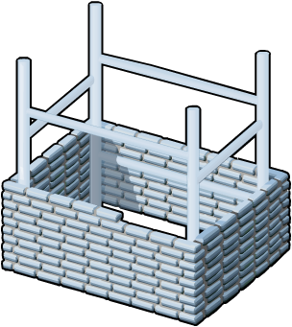
Pamje e pergithsme e AD DS dhe DNS
AD DS kerkon infrastrukturen DNS.
Emrat e domaineve AD DS duhet te emertohen sipas emrave DNS
DNS Domain Name
DNS
Rekordet e domain kontrollerave AD DS duhet te regjistrohen ne DNS per te aktivizuar domain controllerat e tjere dhe kompjuterat kliente per te lokalizuar domain controllerat
Zonat DNS zones mund te ruhen ne AD DS si zona te integraura Active Directory
DNS Zone

Slide 12
Pamje e komponenteve
AD DS perbehet nga kompnentet fizike dhe logjike
Komponente fizike | Komponente logjike
Data baza Domain controller-at Serveri i katalogut global Domain Controller Read-Only (RODC) | Partitconet Schema/Skema Domains/doamine Domain trees/ pemet e domaineve Forests/pylli Sites/sitet Organizational units (OUs)/Njesite organizative
Notes:
Physical components
Data store: Stores the AD DS information. This is a file on each domain controller.
Domain Controller Server and read-only domain controller (RODC): Contains a copy of AD DS database.
Global catalog servers: Host the global catalog, which is a partial, read-only copy of all the domain naming contexts in the forest. A global catalog speeds up searches for objects that might be attached to other domain controllers in the forest.
Logical components
Partitions: Various partitions exist in AD DS: domain directory, configuration directory, schema directory, global catalog, application directory.
Schema: Defines the list of attributes which all objects in the AD DS can have.
Domains: logical, administrative boundary for users and computers
Domain Trees: Collection of domain controllers that share a common root domain.
Forests: Collections of domains that share a common AD DS.
Sites: Collections of users, groups, computers as defined by their physical locations. Useful in planning administrative tasks such as replication of the AD DS.
OUs: Organizes the elements found at a give site or domain for the purposes of securing them more selectively.

Slide 13
Pamje e komponenteve fizike AD DS
Domain Controllers/Domain controllera
Global Catalog Servers/Servera te katalogut global
Data Store/ data baza
Replication/ Replikimi
Sites/Sitet

Slide 14
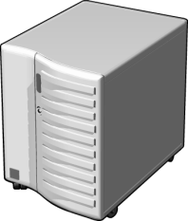
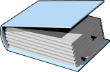
Domain Controllers
A domain controller eshte nje server me rolin e AD DS te instaluar dhe aktiviizuar ne nje domain controller i
Domain controllera:
Ruajne nje kopje te databazes AD DS
Ofrojne sherbimet e autentifikimit dhe autorizimit
Replikojne perditesimet ne DC e tjera ne domain dhe ne forest
Lejojne akses administratiiv per te menaxhuar lllogarite e perdoruesit dhe burimet e rrjetit
Notes:
Each domain controller holds a copy of the directory store, and updates can be made to the AD DS data on all domain controllers except for RODCs.
Have multiple domain controllers in each domain. This provides load balancing, but more importantly, it also provides recoverability if a server failure occurs.
All domain controllers engage in authentication and authorization, thus making it a redundant system with fewer fail-points.

Slide 15
Serverat e katalogut global
Serverat e katalogut gloabal jane domain kontrollera dhe ruajne nje kopje te katalogut global
Katalogu global :
Mban nje kopje te te gjithe objekteve AD DS ne nje forest ku perfshihen vetem disa nga atributet per cdo objekt ne forest
Permireson eficencen e objekteve gjate kerkimit duke shmangur referenca te panevojshme per domain kontrollerat
Kerkon per pedoruesit qe te logohen ne nje domain
Notes:
The global catalog partition is like other partitions in AD DS, but unlike other partitions, administrators cannot enter information directly into this partition. The global catalog builds and updates its content based on values of a schema attribute (isMemberOfPartialAttributeSet), thus deciding when to replicate that attribute of an AD DS object in the global catalog.
Note that the alternative to having a searchable global catalog would be much more traffic over the entire organization’s network.

Slide 16
Cfare eshte databaza AD DS ?
Permaban fiilet e DB se bashku me proceset qe ruajne dhe manxhojne informacionin e direktorise per perdoruesit, sherbimet dhe aplikacionet
Perfshin:
Perbehet nga file Ntds.dit
Ruhet , by default ne folderin %SystemRoot%\NTDS ne te gjithe DC-te
Aksesohet vetem nga proceset dhe protokollet DC
Notes:
The NTDS.DIT file is a database with usually 3 or more tables. The name and purpose of the important tables are the following:
1. datatable - used to store the objects accessible in Active Directory
2. link_table - used to provide references to objects (introduced with Server 2003)
3. sd_table - used to store the security descriptors
The database engine for NTDS.DIT is the Extensible Storage Engine (ESE or JET Blue) and is a proprietary Microsoft database engine. This engine is also used in Microsoft Exchange, however, the pagesizes are different between the two databases. It is 8192 bytes in the NTDS.DIT database and 4096 bytes in Exchange.
The AD DS database cannot be directly accessed by any applications. All access to the database is managed by the domain controller.
64-bit hardware can provide a significant performance boost for domain controllers because of the increase in addressable memory space.

Slide 17
Cfare eshte replikimi AD DS?
Kopjon te gjitha perditesimet qe ndodhin ne DB AD DS ne DC-te e tjera ne nje domain apo ne nje forest
Replikimi AD DS:
Siguron qe te gjithe DC-te te kene te njejtin informacion
Perdor nje model replikimi multimaster
Mund te menaxhohet duke krijuar AD DS sites
Teknologjia e replikimit AD DS krijohet automatikisht sapo nje domain controllet i ri shtohet ne domain
Notes:
If directory information did not replicate regularly:
logons would fail at domains other than where the user account was created
locations and names of domain controllers might not be current, causing services contained on them to become unavailable
Advantages of multi-master replication include:
the elimination of single point of failure
faster replication as each domain controller can be involved with replicating data
Domain controllers in the same site replicate their data, typically within 15 seconds after a change, completing replication with all members in a properly configured tree in about 45 seconds.
When you create multiple sites, you can configure a replication schedule between the sites.

Slide 18
Cfare jane sitet?
Nje site AD DS perdoret per te perfaqsuar nje segment rrjeti ku te gjithe DC-te jane te lidhura npm nje linje te shpejte rrjeti
Sitet jane:
Te asociura me subnete IP
Perdoren per te menaxhuar trafikun e replikimit
Perdoren per te menaxhuar trafikun e klinteve gjate procesimit te logimit
Perdoren nga aplikacione ne nivel site sic jane: Distributed File Systems (DFS) ose Exchange Server-a
Perdoren per te caktuar politikat e ndjekura nga grupet per objektet e perdoruesve dhe kompjuterave ne nje vend per kompanine
Notes:
Sites are often defined after an analysis of network bandwidth capacity.
The primary reason for creating sites is to control network traffic across wide area network (WAN) links. By creating sites, you can minimize replication traffic across the WAN link because you can schedule the replication. You also control client logon traffic and provide a better client logon experience because client computers will always connect to a domain controller in their own site first.

Slide 19
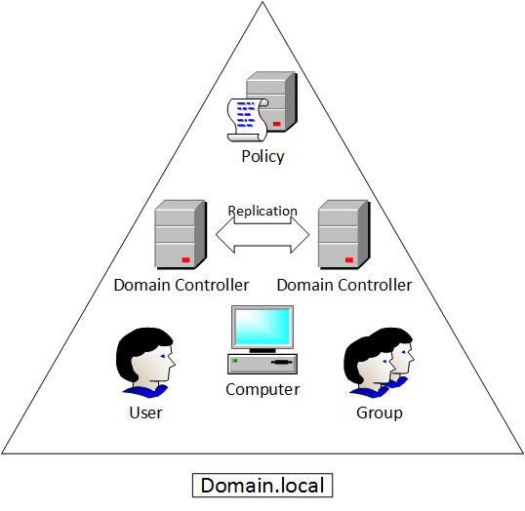
Domainet
Njesite e replikimit
Mirmbahen nga Domain Controller-at
Miliona objekte
Notes:
All of the domain controllers in a particular domain can receive changes and replicate those changes to all other domain controllers in the domain. Each domain in Active Directory is identified by a Domain Name System (DNS) domain name and requires one or more domain controllers.

Slide 20
Pemet

Slide 21
Pamje e komponenteve logjike AD DS
Skema AD DS
Bazat
Lidhjet e besimit
Objektet AD DS

Slide 22
Cfare eshte skema AD?
Skema AD DS:
Percakton cdo lloj objekti qe mund te ruhet ne direktori
Perforcon rregullat ne lidhje me krijimin e objekteve dhe konfigurimin e tyre
Llojet e objekteve | Funksioni | Shembuj
Klasat e objekteve | Cfare lloj objektesh mund te krijohen ne direktori | User Kompjuter
Atributet e objekteve | Informacioni qe i bashkangjitet nje objekti | Display name
Notes:
One of the easiest ways to describe the schema is to say that it is a set of rules that define what you can do in AD DS.
ADSIEdit and the Schema Management Console are tools you can use to manage the schema. You must register the Schema snap-in by using the regsvr32 schmmgmt.dll command before creating the custom MMC.

Slide 23
Bazat e domaineve
Domainet perdoren per te grupuar dhe menaxhuar objekte ne nje organizate
Contoso.com
Domainet:
Kufij administrative per aplikimin e politikave ne grupet e objekteve
Percakton kufijte e replikimit te te dhenave midis DC-ve
Percakton kufijte per autentifikimin dhe autorizimin dhe ofron nje rruge per te limituar aksesin ne burime

Slide 24
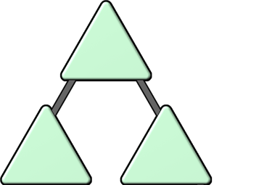
Bazat e pemeve:
Eshte nje hierarki domainesh ne AD DS
contoso.com
emea.contoso.com
na.contoso.com
Te gjithe domain-et ne peme :
Ndajne nje hapesire emertimi me domainin prind
Mund te kene disa domaine femije qe shtohen
By default, krijojne nje lidhje besimi tranzitive me 2 kahje

Slide 25
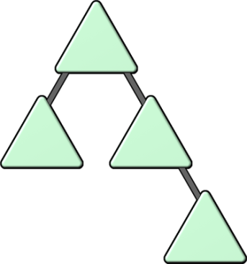
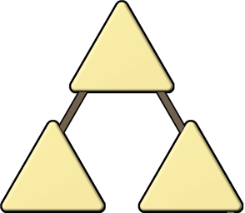
Bazat e foresteve
Bashkesi e nje ose me shume pemeve
Foresti:
Ndajne nje skeme te perbashket
Ndajne nje particion te perbashket te konfigurimit te perticionit
Ndajne te njejtin katalog global per te bere te mundur kerkimin/search
Aktivizojne besimin ne te gjitha domain-et ne forest
Ndajne admin-et dhe grupet e tyre

Slide 26
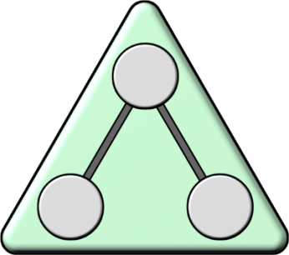
BAZAT per njesite organizative (OU)
OU-te jane konteniere Active Directory qe permbajne perdorues, grupe, PC dhe Ou te tjera
OU-te perdoren per :
Perfqason organizaten nemenyre hierarkike dhe logjike
Menaxhon nje bashkesi objektesh ne menyre konsistente
Delegon lejet per te administruar grupet e objekteve
Zbaton politika
Notes:
OUs can be used to create both a hierarchical and logical representation of a company. OUs can also be used to delegate certain administrative rights. For example, a junior network administrator may be given permission to administer user accounts in an OU that contains all accounts for a branch office location.

Slide 27
Lidhjet e besimit
Ofrojne nje mekanizem qe perdoruesit te perfitojne nga burimet e nje domaini tjeter
Llojet e lidhjeve te besimit | Description | Diagram
Direksionale | Lidhja e besimit shkon nga domaini qe beson tek domaini qe i besohet
Tranzitive | Shkon ne te dyja krahet e domain-eve
Access
TRUST
Trust & Access
Lidhjet e besimit mund te zgjerohen edhe pertej domaineve
Notes:
The trusted domain as the domain where the accounts are, and the trusting domain as where the shared resources are.
Domains can allow access to shared resources outside of their boundaries by using a trust. You can use a one-way trust to optimize performance between domains. Mention that forest trusts allow users to access resources in any domain in the other forest, as well as logon to any domain in the forest using a same VPN.
Realm trusts enable trusts between Windows Server 2003 and Windows Server 2008 domains and directory-service implementations on other platforms by their shared use of open standard security system Kerberos version 5 protocol.

Slide 28
Objektet AD
Object | Description
User/perdorues | Enables network resource access for a user
InetOrgPerson | I ngjajshme me llogarine e perdoruesit I perdorur per perputhshmeri me sherbimet e tjera direktori
Contacts/kontakte | I asenjon adresa e-maili perdoruesve te jashtem Nuk aktivizon aksesin ne rrjet
Groups/grupe | Perdoret per te thjeshtuar administrimin e kontrollit te aksesit
Computers/PC | Aktivizon auditimin dhe autentifikimin e aksesit te PC-ve ndaj burimeve
Printers/printera | Thjeshton procesin e gjetjes dhe lidhjes me printera
Shared folders/foldera te ndare | Aktivizon perdoruesit te kerkojne per foldera te ndare te bazuar ne vetiite e tyre

Slide 29
Module Review and Takeaways
Review Questions
Summary of AD DS
Notes:
Review Questions
1. What are the three core partition types in an AD LDS instance?
Answer: The three main partition types are Schema, Configuration, and Application.
2. What ways are AD DS and AD LDS similar?
Answer: AD LDS and AD DS use the Extensible Storage Engine, enable LDAP client connections, use multimaster replication, and allow for delegated administration.
3. What tools are used to administer AD LDS and for what are each used?
Answer: Active Directory Lightweight Directory Services Wizard is used for creating new instances and new replicas of an AD LDS instance. ADSIEdit and LDP are used for viewing and modifying data. Ldifde and Csvde are used for importing and exporting data. Dsacls is used for viewing and setting permissions. AdamSync is used to synchronizing AD LDS and AD DS.
4. What are some reasons for deploying multiple AD LDS replicas?
Answer: Deploying multiple replicas can provide for high availability, load balancing, and geographic limitations.
5. How would you configure AD LDS if two applications required schema attributes that conflict with one another?
Answer: Because all application partitions in an AD LDS instance share a schema partition, the only way to provide multiple schemas is to deploy two instances of AD LDS, one for each application.
Summary of AD LDS
AD LDS is an LDAP directory service in Windows Server 2008. It provides data storage and retrieval for directory-enabled applications, without the dependencies that are required for AD DS.
AD LDS can have multiple writable replicas of the data on several servers. Having multiple writable copies eliminates the single point of failure. Replication provides high availability, allows for load balancing, and better serves geographically dispersed application access.
AD LDS and AD DS are similar because they both use an ESE database, enable LDAP client connections, use multimaster replication, and allow delegated administration. They provide different functionality as AD DS is an enterprise directory for administration and management, and AD LDS is a lightweight customizable solution for applications to use for authentication and data storage.

