Slide 1
Te kuptojme “Active Directory”
Christopher Chapman | MCT
Content PM, Microsoft Learning, PDG Planning , Microsoft
Notes:
1 minute

Slide 2
Sherbimet federate “Active Directory”
(AD FS)

Slide 3
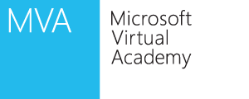
Cesthje:
Pamje e pergjithshme e sherbimeve federate AD FS
Skenaret e shperndarjes AD FS
Konfigurimi i komponenteve AD FS
Notes:
Module 6: Introduction to Active Directory® Federation Services
Course 6424A

Slide 4
Ceshtja 1
Cfare eshte identiteti i federates?
Si ndodh implementimi i tyre?
Benefite te shperndarjes se sherbimeve federate AD FS
Notes:
Module 6: Introduction to Active Directory® Federation Services
Course 6424A

Slide 5
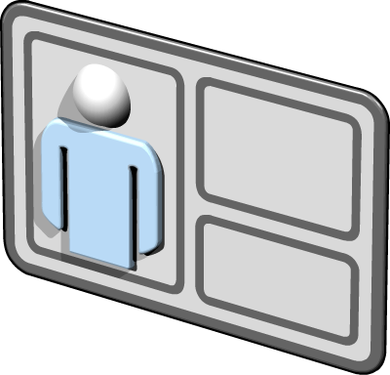
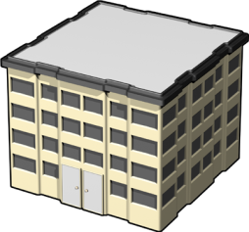
Cfare eshte identiteti federate?
Eshte nje proces qe aktivizon idnetifikimin e shperndare, autentifikimin, dhe autorizimin ne te gjithe hapesiren e organizates dhe platformes.
Identiteti i federates:
Kerkon lidhje besimi ndermjet dy organizatave apo entiteteve
Lejon organizaten te fitoje kontroll tek:
Aksesi i burimeve
Perdoruesit e tyre dhe llogarite e perdoruesit te grupeve
Notes:
Identity Federation allows for separate authentication domains or realms to be able to share resources without having to provide complete access to each of the authentication domains.
So what does this REALLY mean? In the real world everyone has a number of username and passwords that they must remember, even in the same organizations or within partner organizations. Identity federation allows for different authentication domains/realms to provide single sign-on (SSO) services. This can be done without creating a full Active Directory trust between the organizations.
Module 6: Introduction to Active Directory® Federation Services
Course 6424A

Slide 6
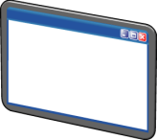
Cfare jane skenaret e identitetit te federates?
Federate per business-to-business (B2B)
Federate per business-to-consumer ose business-to-employee ne nje skenar web ku behet nje logim i vetem
Federate ne nje organizate te vetme ne aplikacione te shumefishta Web
Notes:
Federation for B2B
Enables businesses to provide SSO for a business partner or other business unit that has a separate domain.
Federation for business-to-consumer or business-to-employee in a Web single sign-on scenario
This design allows a business that had a perimeter network domain to provide authentication for internal user accounts.
Federation within an organization across multiple Web applications
This provides SSO across multiple Web applications. No trusts exist in this scenario.
Module 6: Introduction to Active Directory® Federation Services
Course 6424A

Slide 7
Benefite te shperndarjes se sherbimeve federate AD FS
Benefite te meposhtme:
Ofron permiresime:
Siguri dhe kontroll mbi autentifikimin
Rregullator perputhshmerie
Aktivitet me sistemet heterogjene
Funskionon me sherbimet direktori (AD DS) por edhe sherbimet Lightweight Directory Services (AD LDS)
I ben aktive sherbimet direktori AD DS ne Internet
Notes:
AD FS provides the benefits that the following section details:
Enables improved:
Security and control over authentication. You establish rules to control which users are allowed to authenticate across the federated trust.
Regulatory compliance. Because of controlled authentication, and not providing business partners or Internet users direct authentication with your corporate domains, this enables scenarios that would allow you to maintain regulatory compliance.
Interoperability with heterogeneous systems. AD FS leverages Web services, so it can interoperate with many heterogeneous systems. Whitepapers have been created to set up this interoperation.
AD FS works with AD DS or AD LDS, which allows for flexibility and INSERT use with other third-party applications.
Extends Active Directory to the Internet, as it allows for users on the Internet to authenticate against AD DS for use in Web applications.
Module 6: Introduction to Active Directory® Federation Services
Course 6424A

Slide 8
Ceshtja 2
Cfare eshte lidhja e besimit federate?
Cilet jane komponentet ne sherbimin AD FS?
Si ofrohet sherbimi i identitetit te federates ne nje skenar B2B
Si shkon trafiku ne sherbimin federate AD FS ne nje skenar B2B
Si e ofron sherbimi federate AD FS Web nje logim te vetem
Integrimi AD FS dhr AD RMS
Notes:
Module 6: Introduction to Active Directory® Federation Services
Course 6424A

Slide 9
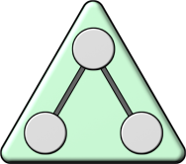
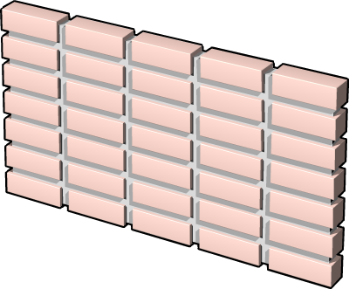
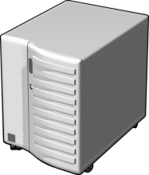
Cfare eshte lidhja e besimit federate?
AD DS
Web Server
Federation Trust
Serveri federate i llogarive
Serveri federate i burimeve
Account Partner Organization
Resource Partner Organization
Notes:
This trust is one way and the arrow pointer is always where the accounts come from. The side of the trust where the accounts are managed is the “account partner”, while the side of the trust that has the resources that will be accessed is the “resource partner”. However, federation trusts are not like Windows trusts. In a federation trust, the federation servers in the account partner and the resource partner do not need to communicate directly with each other.
Module 6: Introduction to Active Directory® Federation Services
Course 6424A

Slide 10
Cfare jane komponentet e sherbimit federate AD FS ?
Komponentet AD FS :
Domain Controllerat AD DS
Account federation server/Serveri federate i llogarive
Account Federation Service Proxy/Sherbimi PROXY per llogarite federate
Resource Federation Server/Serveri i burimeve federate
Resource Federation Server Proxy/Proxyy Server per sherbimet federate
AD FS Web Agent/Agjenti Web AD FS
Notes:
AD DS domain controllers
Domain controllers store directory data and manage user and domain interactions, including user logon processes, authentication, and directory searches.
Federation servers
A federation server is a computer that runs a specialized Web service that can issue, manage, and validate requests for security tokens and identity management. Security tokens consist of a collection of identity claims, such as a user's name or role. In addition, a federation server can protect the contents of security tokens in transit with an X.509 certificate, which makes it possible to validate trusted issuers.
Federation Service Proxies
You can use a federation server proxy to enhance the security and performance of your Active Directory Federation Services (AD FS) 2.0 deployment. When you install the AD FS 2.0 software on a computer and configure it for the federation server proxy role, that computer functions as proxy server in a perimeter network (also known as a screened subnet) for a protected Federation Service on an internal network.
AD FS Web Agent
Active Directory Federation Service (AD FS) Web Agents are Internet Server Application Programming Interface (ISAPI) extensions. They run on Internet Information Services (IIS) and Windows Server, and they manage security tokens and authentication cookies for the Web server. An AD FS Web Agent intercepts incoming client URL requests for a protected resource and ensures that a valid authentication token is presented.
Module 6: Introduction to Active Directory® Federation Services
Course 6424A

Slide 11
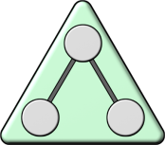
Si ofron AD FS Identitet Federate ne nje skenar B2B
INTRANET FOREST
PERIMETER NETWORK
Resource Federation Server Proxy
AD DS
Account Federation Server Proxy
Resource FederationServer
Account Federation Server
AD FS-enabled Web Server
Federation Trust
Contoso
Online Retailer
Notes:
Module 6: Introduction to Active Directory® Federation Services
Course 6424A

Slide 12
Si kalontrafiku AD FS ne nje skenar Business to Business
5
4
Web Server
AD DS
1
3
2
Account Federation Server
Resource Federation Server
Federation Trust
Contoso
Online Retailer
Notes:
In this design, external users, such as customers, can access the Web application by authenticating to the external account federation server, which is located in the perimeter network. External users have user accounts in the perimeter-network Active Directory forest. Internal users, such as employees, also can access the Web application by authenticating to the internal account federation server, which is located in the internal network. Internal users have accounts in the internal Active Directory forest.
If the Web-based application is a Windows NT token-based application, the AD FS Web Agent that is running on the Web application server intercepts requests and creates Windows NT security tokens, which are required by the Web application to make authorization decisions. For external users, this is possible because the AD FS-enabled Web server that hosts the Windows NT token-based application is joined to the domain in the external forest. For internal users, this is enabled through the forest trust relationship that exists between the perimeter forest and the internal forest.
If the Web-based application is a claims-aware application, the AD FS Web Agent that is running on the Web application server does not have to create Windows NT security tokens for the user. The AD FS Web agent can expose the claims that come across, which makes it possible for the application to make authorization decisions based on the contents of the security token that is provided by the account federation server. As a result, when it deploys claims-aware applications, the AD FS-enabled Web server does not have to be joined to the domain, and the external-forest-to-internal-forest trust is not required.
Module 6: Introduction to Active Directory® Federation Services
Course 6424A

Slide 13
Ceshtja 3
Opsionet e konfigurimit te sherbimit federate
Cilat jane politikat ne lidhjet e besimit AD FS?
Opsionet e konfigurimit te agjentit proxy web AD FS
Cfare jane ankesat AD FS?
Notes:
Module 6: Introduction to Active Directory® Federation Services
Course 6424A

Slide 14
Opsionet e konfigurimit te sherbimit federate
Per te implementuar sherbimet federate:
Krijo nje politike besimit per burimet dhe llogarite partnere
Krijo ankesat ne nivel organizate
Krijo hapesirat e magazinimit per llogarite
Krijo dhe konfiguro aplikacionet
Notes:
Briefly talk about the main settings that will need to be configured before AD FS is functional:
Create organizational claims
Create account stores
Create applications
Create a trust
Module 6: Introduction to Active Directory® Federation Services
Course 6424A

Slide 15
Cfare jane politikat e besimit ne sherbimet federate?
Politikat e besimit jane specifiakat e konfigurimit qe percaktojne si te konfigurojme nje lidhje besimi federate dhe si funksionon lidhja e besimit federate
Politikat e besimit per burime tek partneret perfshijne:
Token Lifetime
Federation Service URI/Sherbimi federate URI
Federation Service endpoint URL/Pika fundore per sherbimin federate URL
Opsioni per te perdorur nje lidhje besimi Windows per kete partner
Politikat e besimit per llogarite partnere perfshijne:
Vendndodhja per nje certifikate per te verifikuar partnerin burim
Opsione per te konfiguruar sesi burimet e llogarive krijohen
Notes:
Discuss how the trust policies really are the definition of the trust functions,.
Then describe each of the configuration options for the resource and account partners trust policies.
Module 6: Introduction to Active Directory® Federation Services
Course 6424A

Slide 16
Opsionet e konfigurimit per agjentitn web Proxy ne sherbimet federte
Perfshijne:
1
Install the AD FS Web Agent on the IIS server
Windows Token-based authentication requires ISAPI extensions
Claims-aware authorization can authenticate natively with ASP.NET
Determine how to collect user credential information from browser clients and Web applications
2
Notes:
Module 6: Introduction to Active Directory® Federation Services
Course 6424A

Slide 17
Cfare jane ankesat per sherbimet federate AD FS ?
Lloji i ankeses | Pershkrimi
Identiteti | UPN: indicates a Kerberos version 5 protocol-style user principal name (UPN), for example: user@realm E-mail: indicates Request for Comments (RFC) 2822–style e-mail names of the form user@domain Common name: indicates an arbitrary string that is used for personalization
Grupi | Indicates membership in a group or role
Custom | Indicates a claim that contains custom information about a user, for example, an employee ID number
Notes:
Define an AD FS claim, and then talk about each type: identity, group, and custom. Be sure to talk about how they differ and, if possible, give an example of each.
The table below shows more information than the slide table:
Module 6: Introduction to Active Directory® Federation Services
Course 6424A

